Slide 1
Things Fall Apart BACKGROUND
Mr. Pogreba
Helena High School
Honors English II

Slide 2
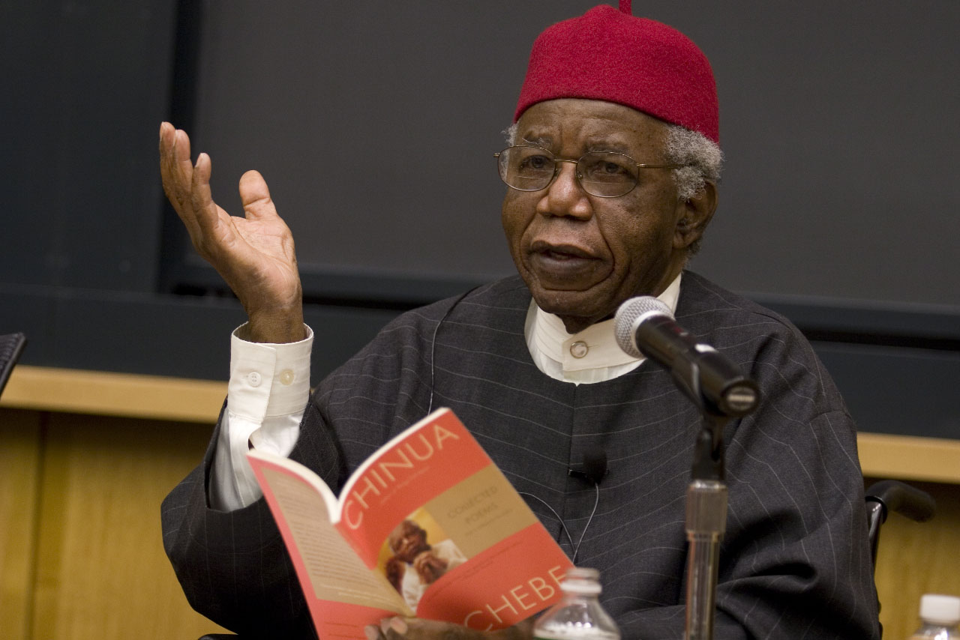
CHINUA ACHEBE

Slide 3
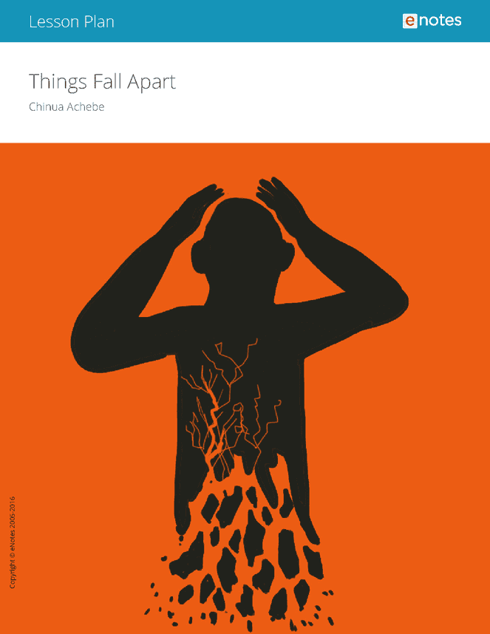
ACHEBE’s BIOGRAPHY

Slide 4
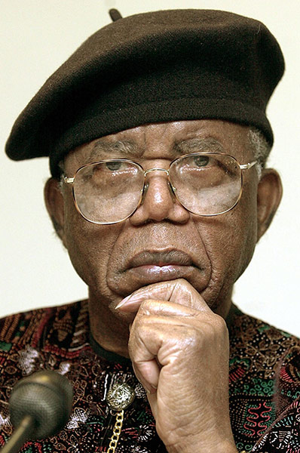
LIFE AND WORK
Born in Nigeria, a member of the Ibo tribe
Though he was raised within the traditions of the Igbo people, Achebe was also raised by Westernized parents who raised him as a Christian.
At college, Achebe rejected his Christian name, Albert, and took the Igbo name Chinua.
Achebe’s work embraces the idea at the heart of African oral tradition that “art is, and always was, at the service of man. Our ancestors created their myths and told their stories for a human purpose." As a result, Achebe believes that "any good story, any good novel, should have a message, should have a purpose."

Slide 5
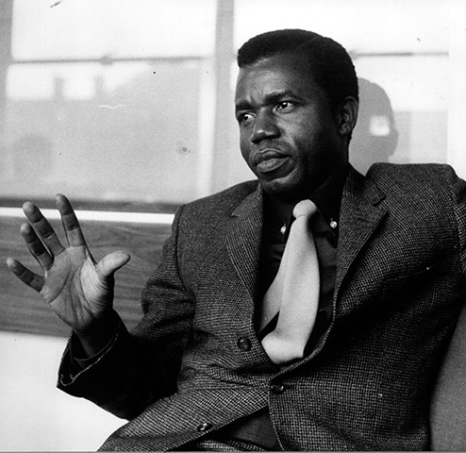
ACHEBE’S LEGACY
Is credited with being the first Nigerian (and perhaps African) author to “successfully transmute the conventions of the novel, a European art form, into African literature” (King).
Many people argue that Achebe should have won the Nobel Prize for Literature, but he never did.
He did win the Mann Booker Prize, one of the most prestigious awards for English language novels.

Slide 6
TECHNIQUES & PURPOSE

Slide 7
TECHNIQUES
Use of the language and aphorisms of oral culture
Achebe’s goal is to blend the rhythms and patterns of African oral tradition with English, arguing that “"English of the African will have to be a new English, still in communion with its ancestral home but altered to suit its new African surroundings.“
Desire to use English as a means to tell the stories of African people, in the manner of African storytellers
Elevated diction of the Ibo people—to contrast with earlier pidgin representations and to give a sense of a foreign language within English.

Slide 8
TECHNIQUES CONTINUED
Frequent use of proverbs, folktales, and religious tenets conveyed through prayer, speeches and song sequences.
Narrative voice is somewhat detached
Connection to nature. Natural connections and names are used to establish the connection of the Ibo people to the natural world.
Nigerian Nobel laureate Wole Soyinka has described Things Fall Apart as "the first novel in English which spoke from the interior of the African character, rather than portraying the African as an exotic, as the white man would see him."
“Proverbs are the palm-oil with which words are eaten."

Slide 9
ACHEBE’S CONCERN WITH REPRESENTATION OF AFRICA
Look in the slide notes below for topics to consider talking about
Notes:
Consider talking about:
Language choice

Slide 10
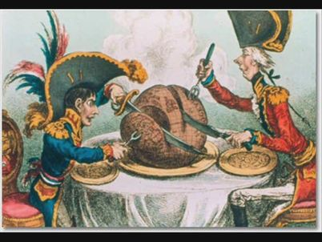
CRITIQUE OF EUROPEAN VISION
Desire to Promote African Culture and Aesthetics
“African people did not hear of culture for the first time from Europeans; that their societies were not mindless but frequently had a philosophy of great depth and value and beauty, that they had poetry and above all they had dignity.” –Chinua Achebe
Achebe’s work seeks to demonstrate the beauty of African values and culture, separate from colonial influence.
Achebe argued in 1975 that European attempts to write about Africa were nothing more than, ““the need—in Western psychology to set up Africa as a foil to Europe”
Achebe, Chinua. “An Image of Africa: Racism in Conrad’s Heart of Darkness.” Heart of Darkness A Norton Critical Edition. Ed Robert Kimbrough. New York: Norton, 1988: 251-262.

Slide 11
CRITIQUE OF THE WESTERN CANON
In particular, Achebe criticized Joseph Conrad’s Heart of Darkness and Joyce Cary’s Mister Johnson.
“Africa as a setting and backdrop which eliminates the African as a human factor… Can nobody see the preposterous and perverse arrogance in thus reducing Africa to the role of props for the break up of one petty European mind? But that is not even the point. The real question is the dehumanization of Africa and Africans which this age-long attitude has fostered an continues to foster in the world. And the question is whether a novel which celebrates this dehumanization… can be called a great work of art. My answer is: No it cannot.”

Slide 12
IMPORTANCE OF AFRICAN LITERATURE
Achebe’s goal is two-fold:
1) to tell the Western world that African culture has value, and
2) to remind Africans of the importance of their own cultural traditions.
“The whole idea of a stereotype is to simplify. Instead of going through the problem of all this great diversity - that it's this or maybe that - you have just one large statement; it is this.” –Chinua Achebe

Slide 13
ONLY THE STORY
"...only the story...can continue beyond the war and the warrior.
It is the story that outlives the sound of war-drums and the exploits of brave fighters.
It is the story...that saves our progeny from blundering like blind beggars
into the spikes of the cactus fence.
The story is our escort; without it, we are blind.
Does the blind man own his escort? No, neither do we the story;
rather it is the story that owns us and directs us.
--Chinua Achebe, Anthills of the Savannah

